Slide 1

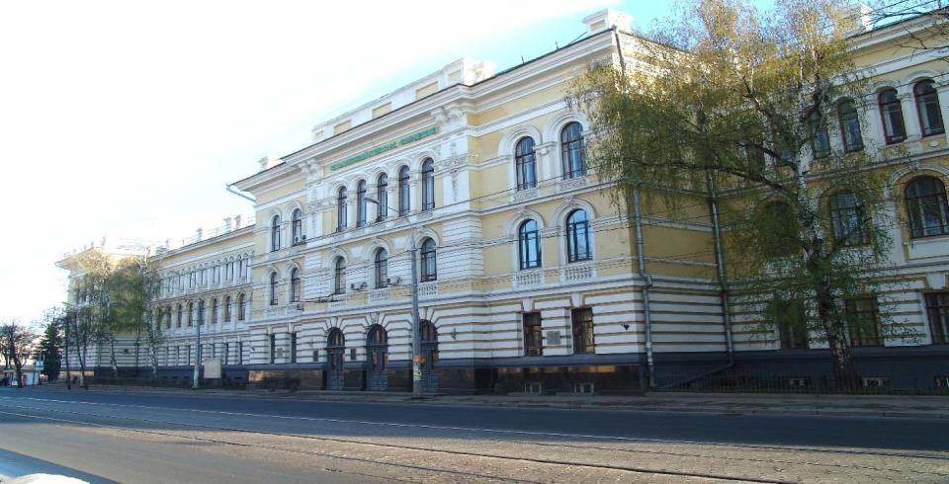

Kazan State Agrarian University

Slide 2
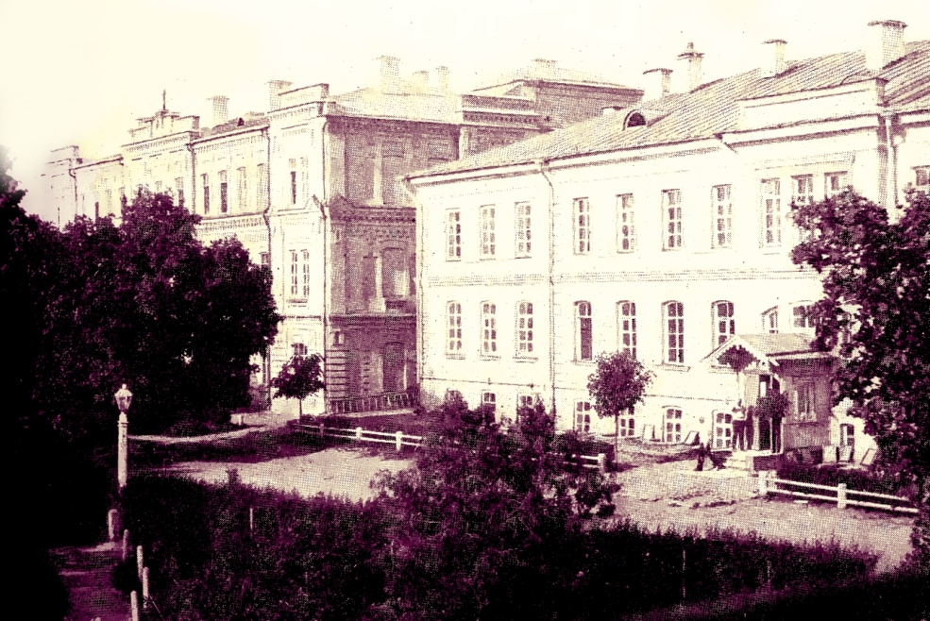
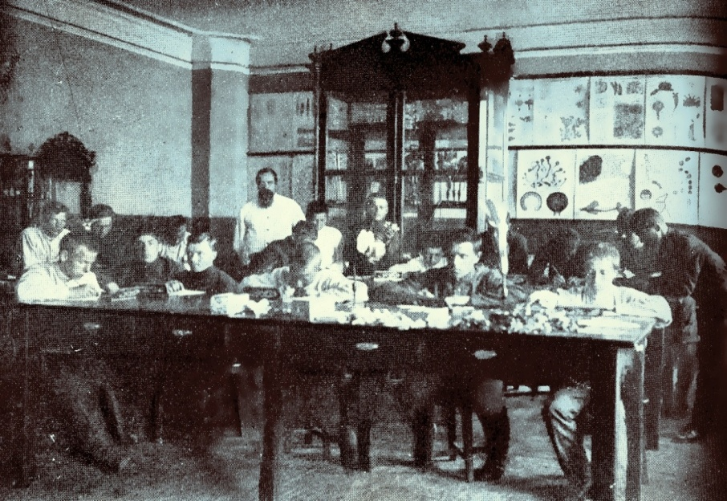
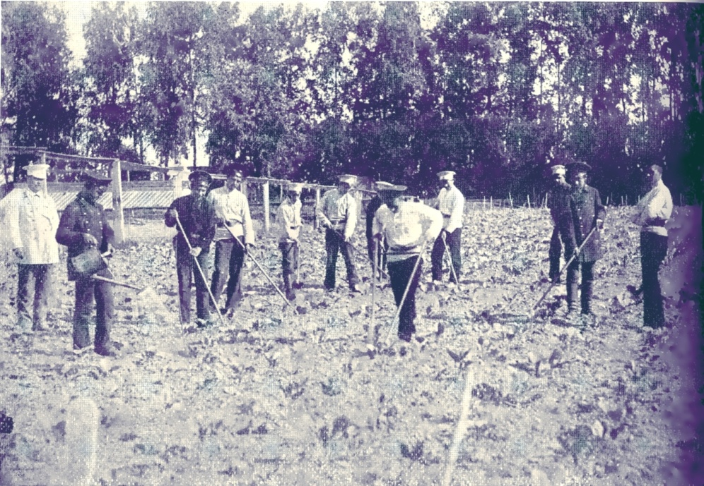
The Kazan State Agrarian University
is the oldest higher-educational institution of agriculture in Russia
It was founded on
May 22, 1922

Slide 3
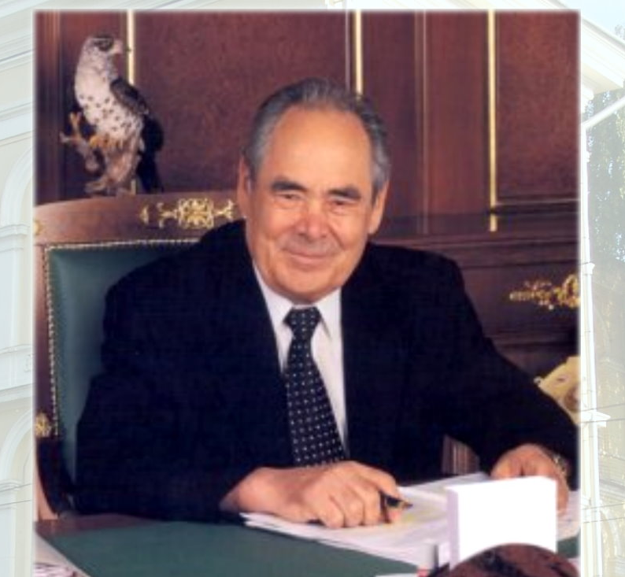
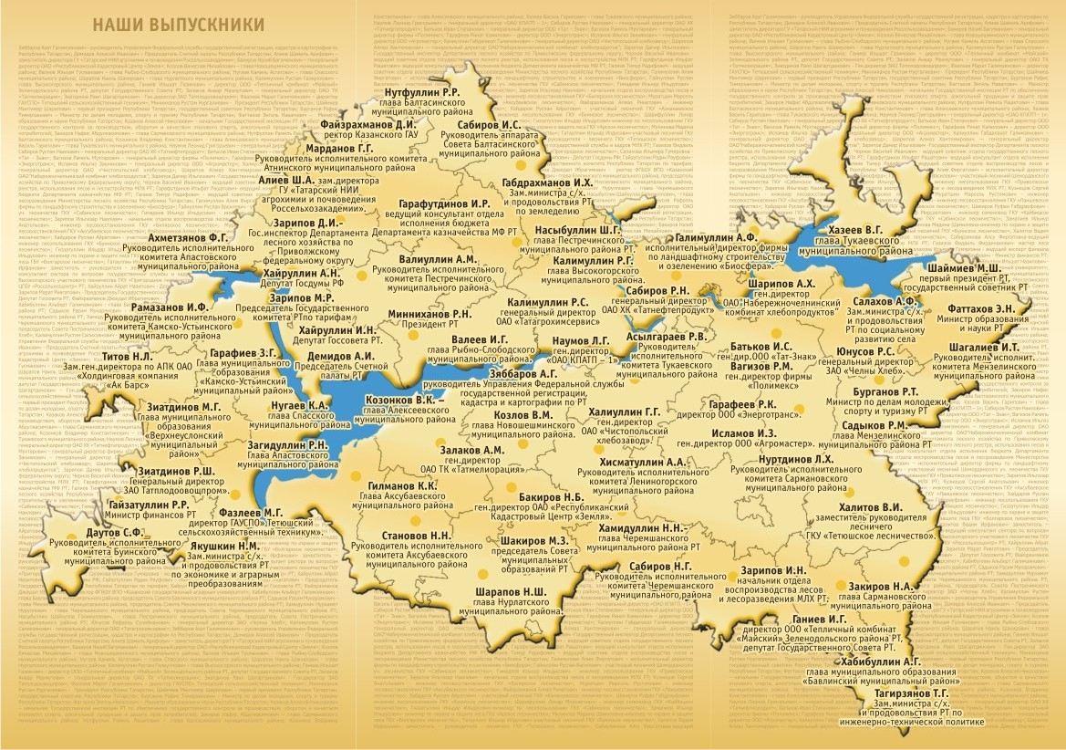
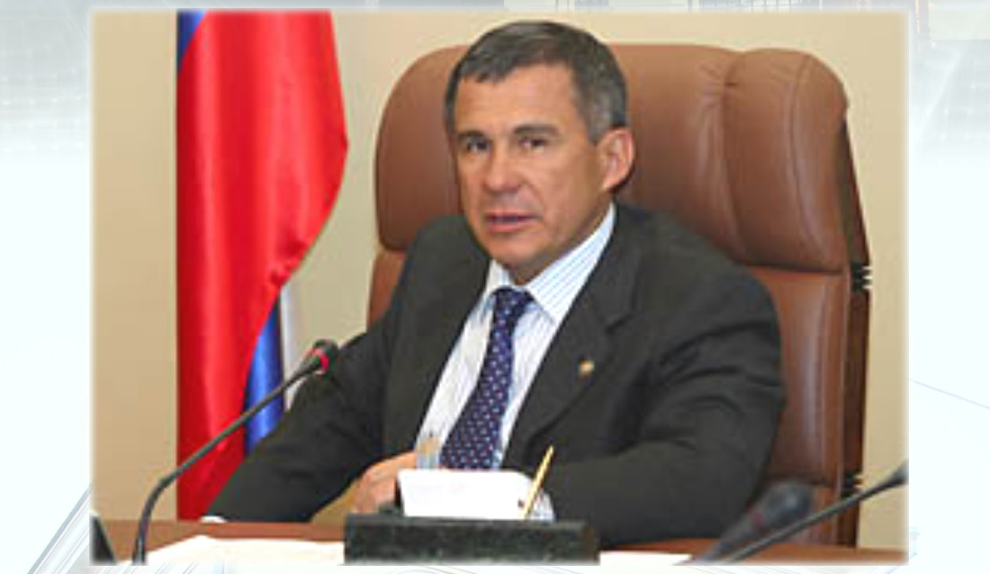
Our Famous Graduates
First President of the Republic of Tatarstan,1991-2010
President of the Republic of Tatarstan from 2010
Kazan SAU have prepared 36000 graduates for agrarian sector

Slide 4
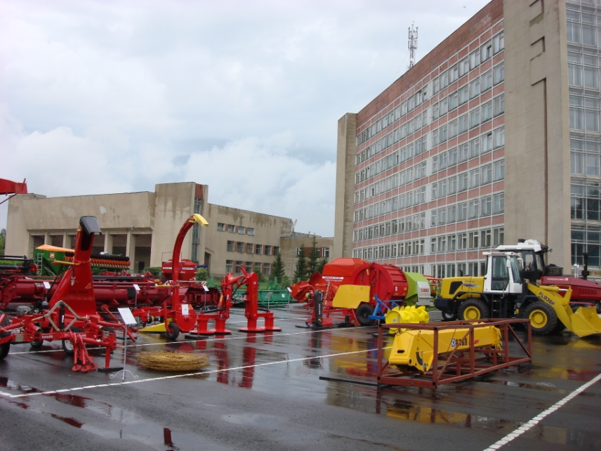
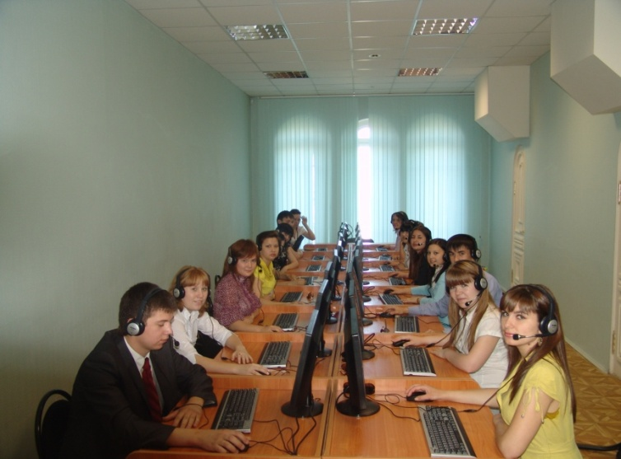
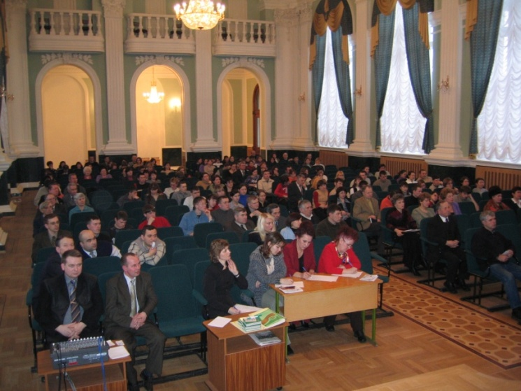
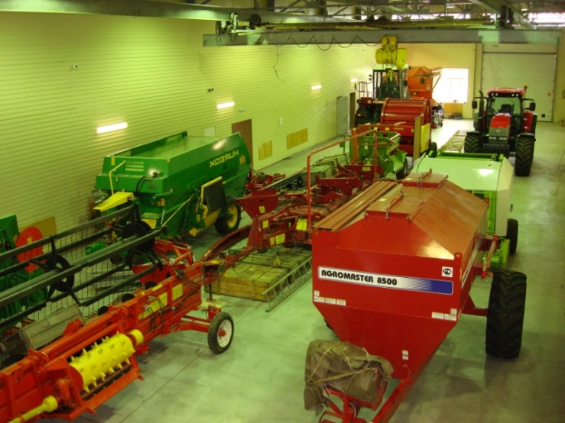
At present Kazan State Agrarian University is a major scientific and educational centre.
Kazan SAU provides opportunities for all main stages of lifelong learning – pre-university training, 18 study programmes at bachelor and 12 Master programmes, practical training, postgraduate studies (PhD, Dr.Sc.), in-service and retraining programs, business educational programs (MBA)

Slide 5
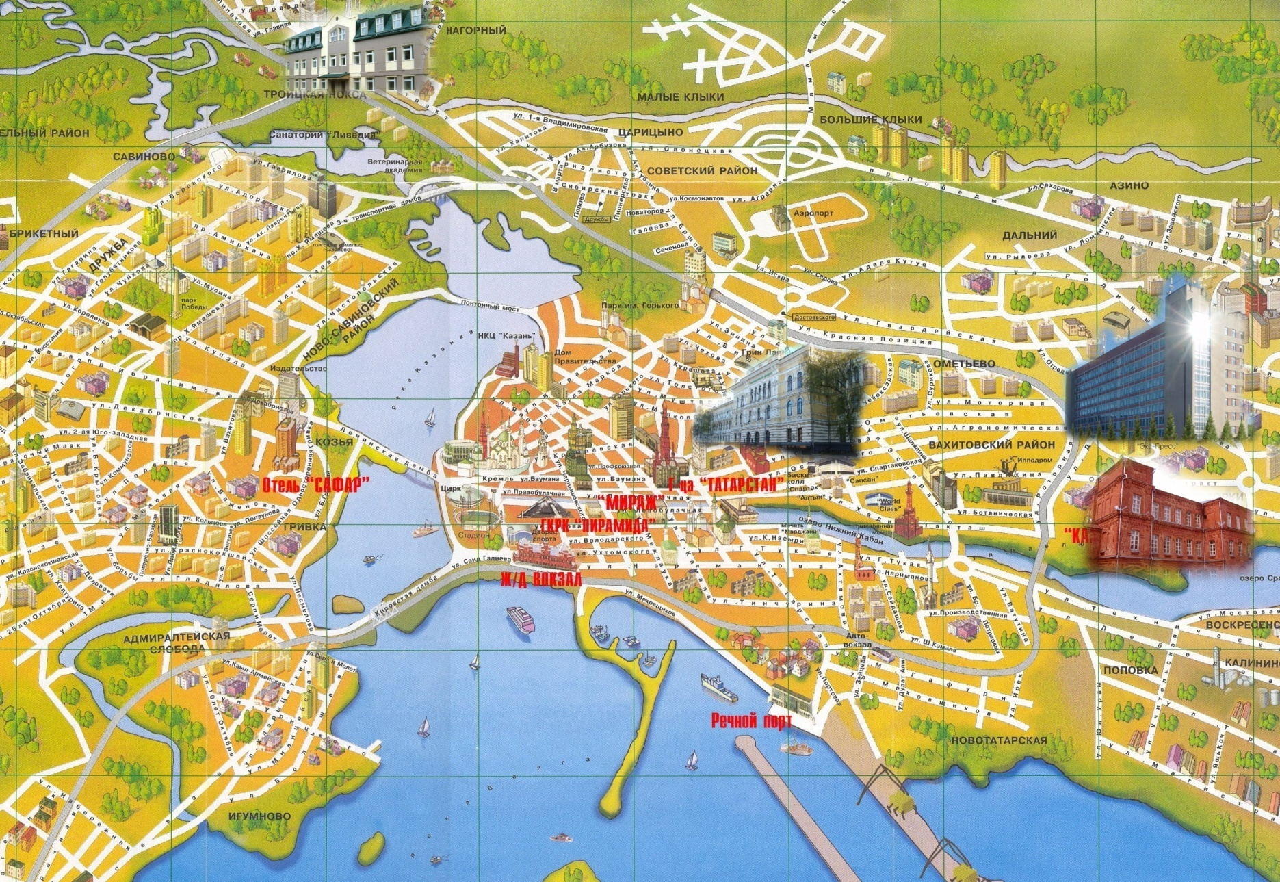
There are 2 Faculty and 2 Institutes
at the Kazan State Agrarian University
Institute of Farm Mexanization
and Technical Service
Forestry and
Ecology Faculty
Institute of Economics
Agronomy Faculty

Slide 6
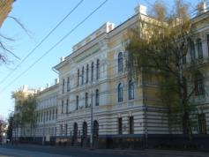
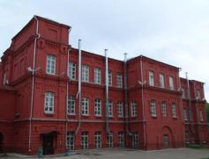
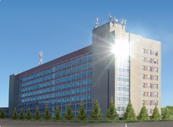
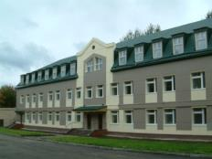
Kazan State Agrarian University
27 academic departments,
5500 students;
43 professors;
130 PhD;
137 post-graduates.
Institute of Economics
Agronomy Faculty
Institute of Farm Mexanization
and Technical Service
Forestry and
Ecology Faculty

Slide 7
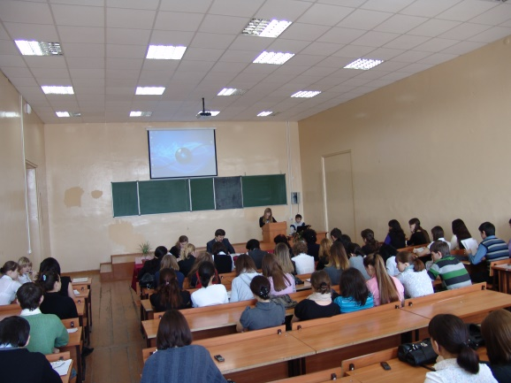
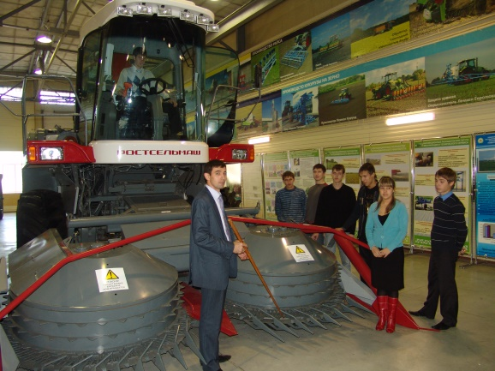
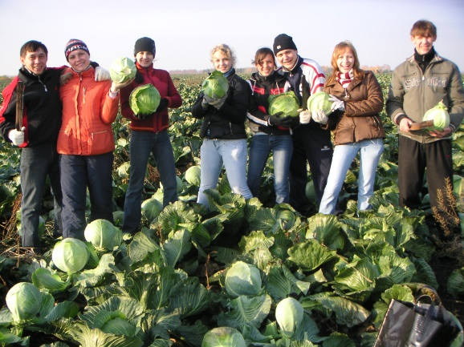
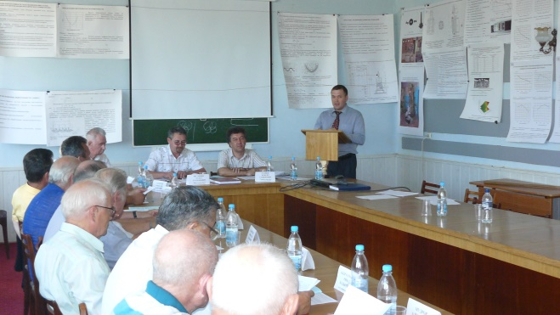
Kazan SAU conducts training in the following specialties:
Agronomy Faculty
- Agronomy;
- Plant Protection;
- agricultural chemistry and soil science
Forestry and Ecology Faculty
- Park-Gardening and Landscaping,
- forest managment,
Institute of Farm Mexanization and Technical Service
- farm mechanization,
- agricultural engineering,
- Electrification and Automation of Agriculture
- technical services in the agricultural sector
Institute of Economics
- Economics and Management in Agricultural Complex,
- Accounting, analysis and audit,
- Finance and credit.

Slide 8
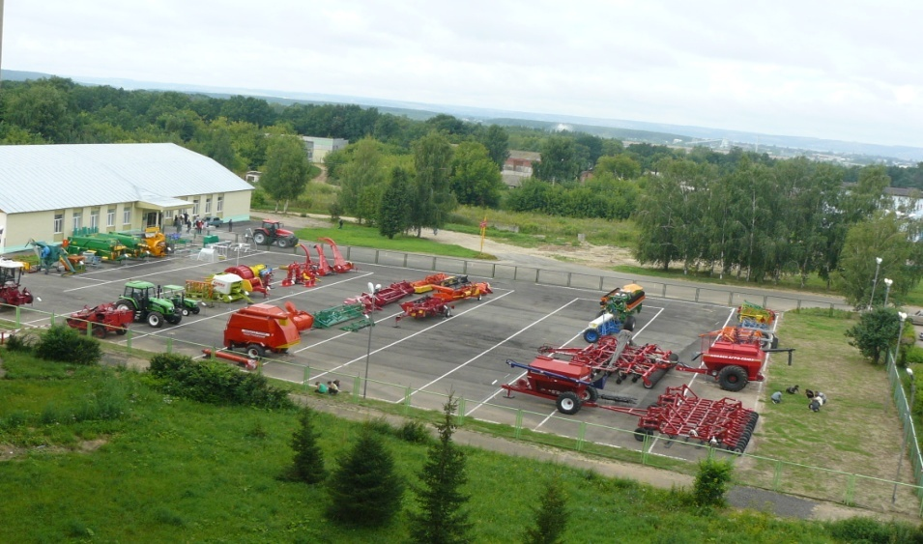
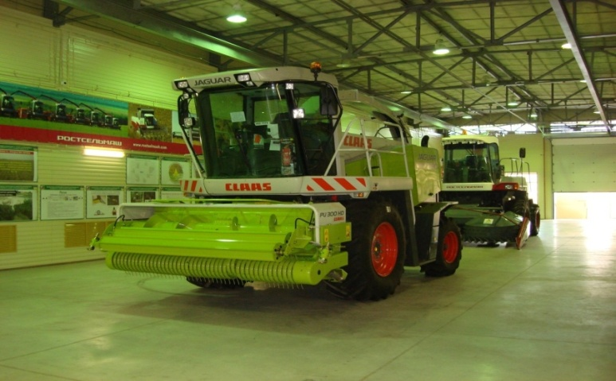
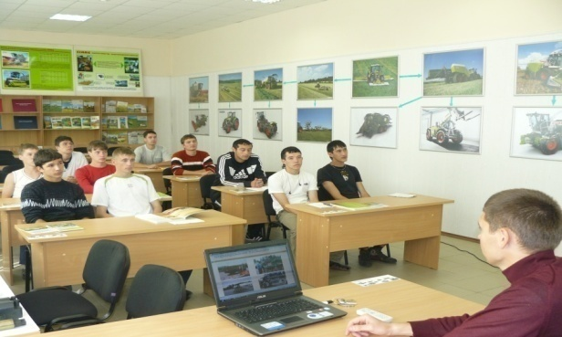
Training and Demonstration Center
about 100 units of the latest
agricultural machinery
Notes:
8
8

Slide 9


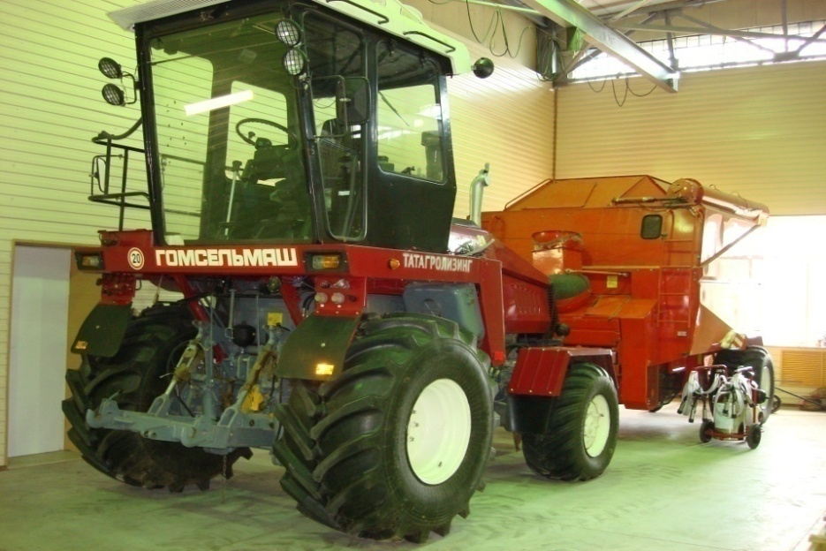




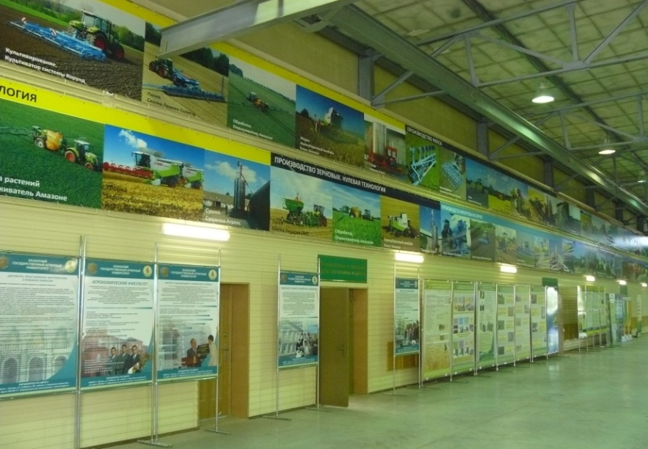

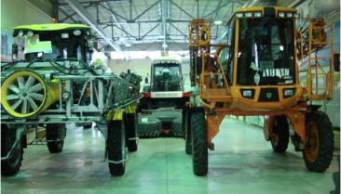

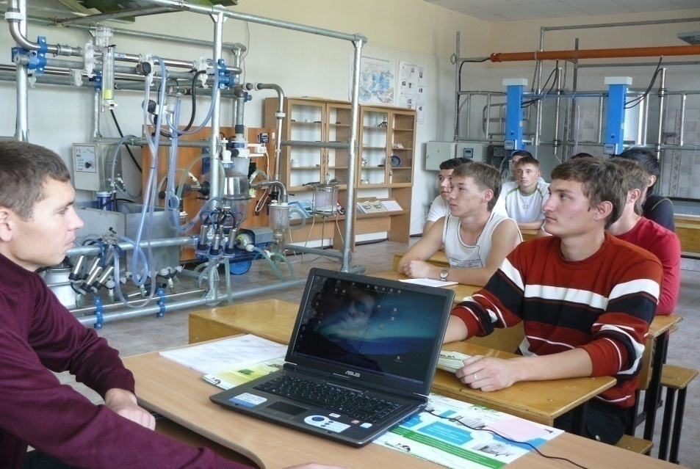


Our partners - about 25 companies that produce agricultural machinery

Slide 10
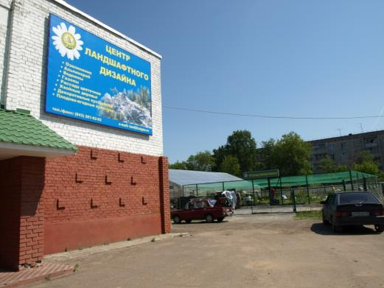
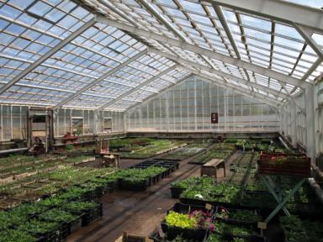
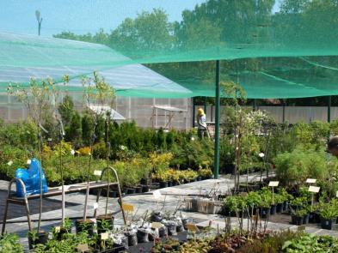

Landscape Design Center

Slide 11
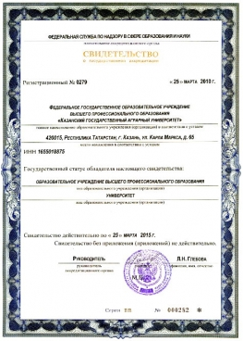
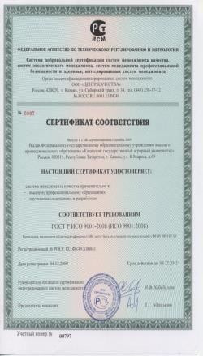
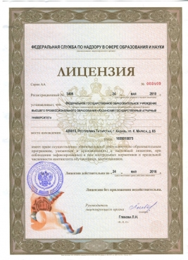
Kazan SAU is accredited by the Ministry of Education and Sciences of the Russian Federation
Certificate of Quality ISO
License of Education
Certificate of State Accreditation

Slide 12
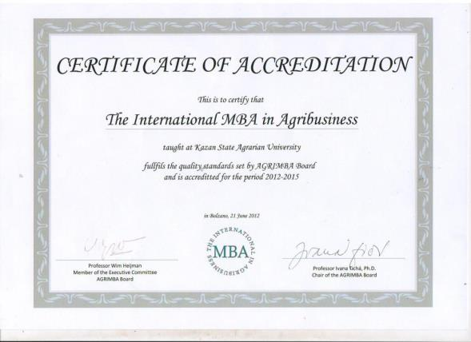
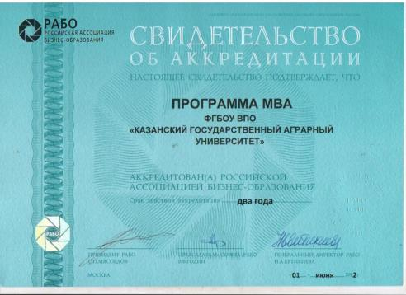

Kazan SAU successfully passed the international external institutional evaluation
Agri-MBA

Slide 13

Development of Public Accreditation of Agricultural programmes in Russia “2013-2016”
The role of KazanSAU is participation in all tasks of activities of the project.
Kazan SAU offers
a group of experts for internal and external quality assurance of agricultural programs
Kazan SAU has
an experience of questionnaire surveys of students, graduates, employers
stable relations with employers
Agricultural Education Cluster

Slide 14


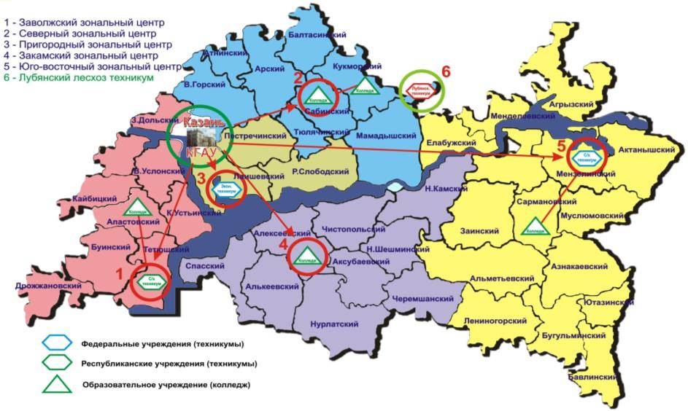
Agricultural Education Cluster

Slide 15
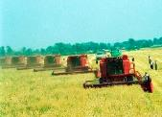
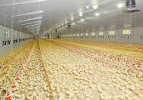
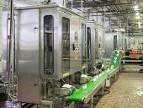
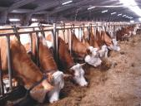
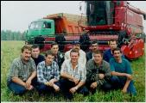
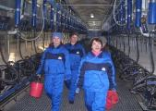
Agroindustrial Complex of the Republic of Tatarstan
Площадь сельхозугодий – 4,5 млн.га.
из них пашни – 3,4 млн.га.
Сельское население – 928 тыс. чел.
Имея 2,3% площади сельхозугодий РФ производит около 5% ее сельхозпродукции
Производит 12,7% валового регионального продукта в т.ч. сельское хозяйство – 7,5%
Занятость в экономике республики –
11% трудоспособного населения,
в т.ч. – 7% в сельском хозяйстве
Кадровый потенциал АПК:
Численность работающих – 112,9 тыс.чел.
в т.ч. специалистов и руководителей – 13,2 тыс.чел.
из них с высшим образованием – 4,8 тыс.чел.
Балтасинский
Атнинский
Кукморский
Арский
Агрызский
В.Горский
Сабинский
Менделеевский
З.Дольский
Елабужский
Казань
Тюлячинский
Актанышский
Пестречинский
Мамадышский
В.Услонский
Р.Слободский
Тукаевский
Мензелинский
Кайбицкий
Лаишевский
Нижнекамский
К.Устьинский
Чистопольский
Заинский
Сармановский
Апастовский
Муслюмовский
Алексеевский
Н.Шешминский
Буинский
Тетюшский
Альметьевский
Азнакаевский
Спасский
Алькеевский
Аксубаевский
Дрожжановский
Черемшанский
Нурлатский
Лениногорский
Ютазинский
- Инвестиционные проекты АПК
Бугульминский
Бавлинский
The development of agribusiness remains one of the priorities in Tatarstan’s economic policy. According to the official rating concerning the development of agribusiness, Tatarstan is first among the subjects of the Russian Federation.

Slide 16
Thank you for your attention

